Slide 1
WHEREVER, WHENEVER
flexit@flex-it.fit
www.flex-it.fit
Spring 2018
Confidential & Proprietary

Slide 2

OPPORTUNITY | SOLUTION | BUSINESS
The fitness space is facing disruption driven by the evolving needs of its customers
36,540
Health and fitness clubs in the United States
57.25 m
Members of health clubs in the United States
67%
Of people with gym memberships never use them
$21.8B
Rev/year of the gym and health club industry
Source: Statista, The Statistics Portal - 2016
Notes:
Other potential taglines:
The Fitness space is under attack by the needs of the dynamic customer
Trends in the fitness space are disrupting the status quo
The fitness space is facing disruption driven by the
Traditional gym models are under attack by the evolving needs of the customer

Slide 3

OPPORTUNITY | SOLUTION | BUSINESS
Traditional gym models are creating problems for gym-goers…
and for gyms
Gym memberships are expensive and inflexible to the needs of the modern worker’s schedule
Difficult to find suitable workout facilities while traveling
Lack of use of a gym membership leads to feelings of guilt and self-doubt that further perpetuate a sporadic workout regimen
Gym memberships are down.
Gyms are underutilized and almost always have excess capacity.
High fixed cost
Increasingly demanding customers that expect personalized service

Slide 4
OPPORTUNITY | SOLUTION | BUSINESS
Leadership throughout the industry has taken notice
Q: WHAT IS THE GREATEST THREAT TO THE FITNESS INDUSTRY TODAY, AND WHAT CAN THE INDUSTRY DO TO OVERCOME THAT?
A: In my opinion, there are actually two: the continued rise of boutique fitness, and the notion that fitness should be available to a consumer anywhere, anytime. People, especially millennials, are searching for personalized experiences and that includes looking for unique feverywhere they go, fitness and workout experiences with a small group of people they connect with on a personal level. Even if they’re traveling or away from home, they expect to be able to keep that routine by walking into a local boutique gym on a per-session basis or by using a digital fitness app outside, in a hotel – or almost anywhere for that matter.
Adam Zeitsiff, CIO - Gold’s Gym International
January 2018

Slide 5

OPPORTUNITY | SOLUTION | BUSINESS
WHAT IF
there was a solution that bridged the gap between gym facilities and its customers?
Notes:
Other potential taglines:
The Fitness space is under attack by the needs of the dynamic customer
Trends in the fitness space are disrupting the status quo
The fitness space is facing disruption driven by the
Traditional gym models are under attack by the evolving needs of the customer

Slide 6

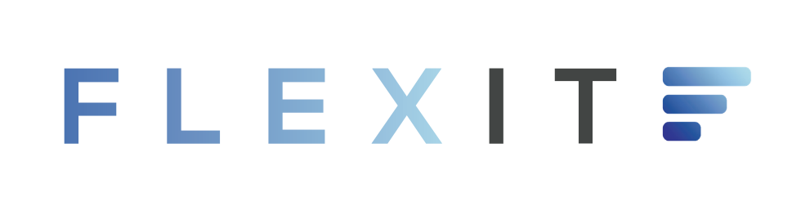
The FlexIt Customer Solution
An a-la-carte, non-membership solution to access health & fitness clubs wherever, whenever
OPPORTUNITY | SOLUTION | BUSINESS
Discover
Check-in
gyms and classes in your community
with a quick and easy scan
Review
FlexIt!
your activity and progress
using the mobile app
Notes:
Not actual screens, just visual representations.

Slide 7





Benefits To Gyms
OPPORTUNITY | SOLUTION | BUSINESS
FlexIt offers flexibility to gym-goers…
Pay for the exact time you use
Flexibility to workout wherever, whenever
Guilt and commitment free
Budget-conscious rates
Notes:
Add personal training sessions here

Slide 8

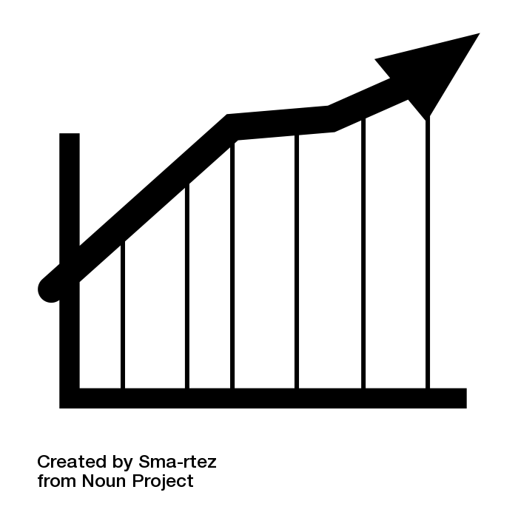



Benefits To Gyms
OPPORTUNITY | SOLUTION | BUSINESS
while increasing revenue and membership for gyms
Increased revenue (via rev share)
New prospective touchpoints
Membership upticks
Increased foot traffic
Organic cross promotion and marketing
Notes:
Add personal training sessions here

Slide 9
OPPORTUNITY | SOLUTION | BUSINESS
FlexIt provides technology to scale for a growing market
3M
Prospective user-base (3Y pro-forma):
Composition of Market
60M
326M
Total available market:
Serviceable obtainable market:
Source: Statista, The Statistics Portal - 2016
Notes:
57.3
Need % that go to the gym less than 8x per month
Maybe concentric circles

Slide 10
OPPORTUNITY | SOLUTION | BUSINESS
FlexIt has a sustainable approach to acquiring customers
Digital
Cost: $$
Effectiveness: High
PR
Cost: $$
Effectiveness: High
Social Media
Influencer
Email
Cost: $$
Effectiveness: High
Cost: $$
Effectiveness: High
Cost: $$
Effectiveness: High
Partnerships
Offline
Cost: $$
Effectiveness: High
Cost: $$
Effectiveness: High
Notes:
Let’s clean slides 13-15 up once the model is done
Based on experience

Slide 11

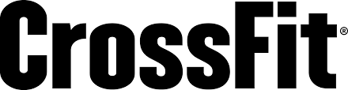
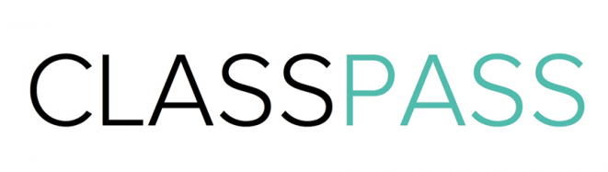

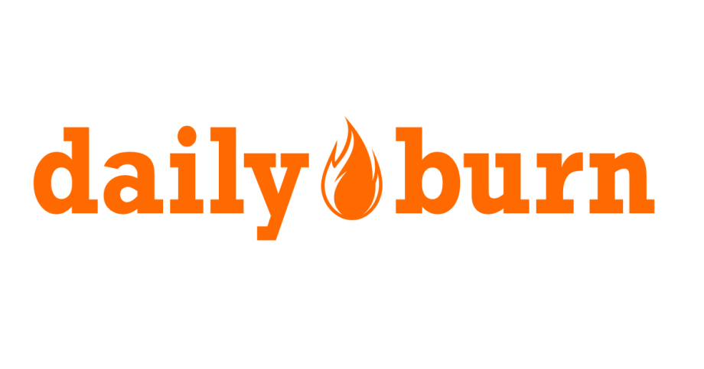



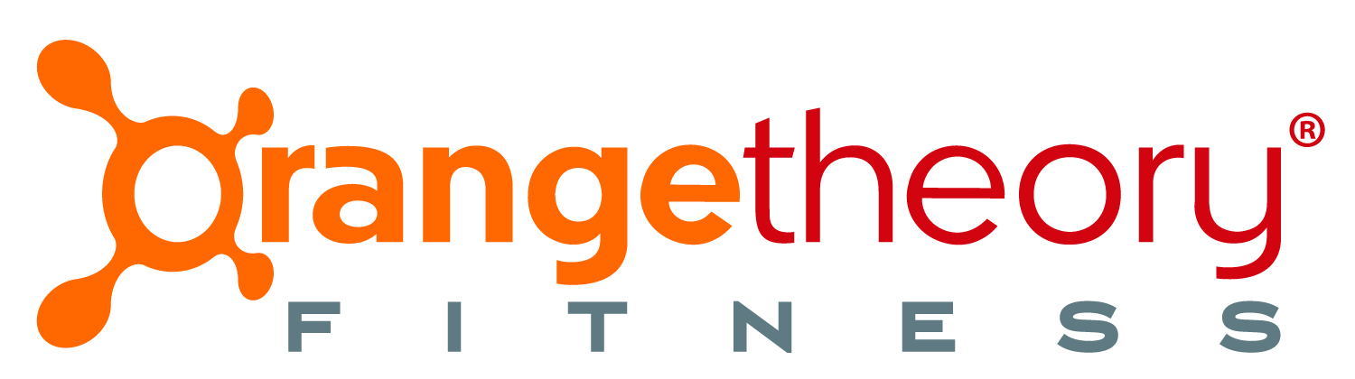
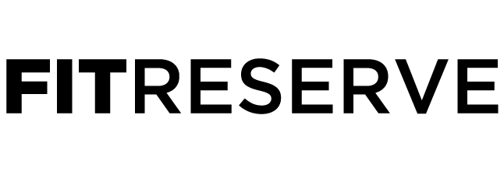
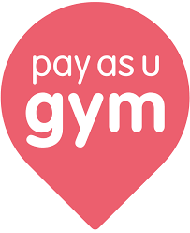
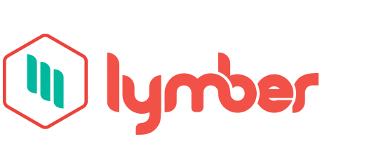

An a-la-carte, non-membership solution to access health & fitness clubs wherever, whenever
OPPORTUNITY | SOLUTION | BUSINESS
FlexIt is more affordable and experiential than its competition
Experiential
Expensive
Affordable
Functional
Notes:
Not actual screens, just visual representations.

Slide 12
OPPORTUNITY | SOLUTION | BUSINESS
What about the platform’s risks?
Risks
Mitigants
Gyms feel threatened by potential loss of membership to pay-as-you-go format
FlexIt will drive trial to gyms from new customers that will create lead generations for new memberships and offset any loss of memberships
Loss of revenue from foregone memberships
Added rev-share opp’tys for gyms with pay-as-you-go customers
Competition from gym day passes and other class-oriented tech platforms
FlexIt will price its per-minute rate competitively with gym day passes, while offering much more streamlined and convenient onboarding
User churn that happens naturally as some customers stop going to the gym
Tech platform provides opp’tys to engage customers on a regular basis to prevent them from slipping in their workout routines

Slide 13
OPPORTUNITY | SOLUTION | BUSINESS
Investment Details
Deal Terms
Uses of Capital
Investment Amount | Up to $500K Convertible Note
Valuation Cap | $2M Cap
Discount | 20%
Interest | 6%
Qualifying Event | $1.5M Raise
$75K | Technology | Customer-facing app Gym-facing app
$75K | PR/Marketing | Launch PR Targeted digital ads
$250K | Personnel/Ops | CTO; COO Biz Dev Hardware Installation Gym Training
$100K | Working Capital | Hardware purchase Inventory & Storage
$500K
Notes:
$1M raise, $2M qualifying event, $4.5M cap
20% discount, 6% interest, 2-year maturity
Safe-Note
$1.8M cap
20% discount, 6% interest, 2-year maturity

Slide 14

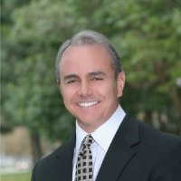
OPPORTUNITY | SOLUTION | BUSINESS
The Team
CEO – Austin Cohen
Sed ornare at felis vel bibendum. Suspendisse suscipit quam in quam facilisis, et facilisis nisi pulvinar. Donec cursus efficitur mi, bibendum egestas nunc maximus sit amet.
TBD – Kevin Batista
Sed ornare at felis vel bibendum. Suspendisse suscipit quam in quam facilisis, et facilisis nisi pulvinar. Donec
Head of Biz Dev – Michael Rojas
Aliquam fringilla aliquet aliquet. Nulla facilisi. Proin ut pulvinar nisl. Pellentesque habitant morbi tristique senectus et netus et malesuada fames ac turpis egestas.

Slide 15
OPPORTUNITY | SOLUTION | BUSINESS
Advisory Board
CEO – Austin Cohen
Sed ornare at felis vel bibendum. Suspendisse suscipit quam in quam facilisis, et facilisis nisi pulvinar. Donec cursus efficitur mi, bibendum egestas nunc maximus sit amet.
TBD – Kevin Batista
Sed ornare at felis vel bibendum. Suspendisse suscipit quam in quam facilisis, et facilisis nisi pulvinar. Donec
Head of Biz Dev – Michael Rojas
Aliquam fringilla aliquet aliquet. Nulla facilisi. Proin ut pulvinar nisl. Pellentesque habitant morbi tristique senectus et netus et malesuada fames ac turpis egestas.

Slide 16
Workout wherever, whenever. Just
Austin Cohen
516.417.2741
flexit@flex-it.fit
FlexIt,Inc. Is an a-la-carte non-membership solution to access health and fitness clubs wherever, whenever. FlexIt provides on-demand access to gyms so that users can enjoy the privileges of membership without the hassle, and pay solely for the time they use.
This presentation contains forward-looking statements. In some cases, you can identify forward-looking statements by terms such as “may,” “will,” “should,” “could,” “would,” “expects,” “plans,” “anticipates,” “believes,” “estimates,” “projects,” “predicts,” “potential,” and similar expressions. Forward-looking statements involve assumptions, variables, risks, and uncertainties that may cause actual results, performance, or financial conditions to be materially different from the expectations of future results, performance or financial conditions expressed or implied in such forward-looking statements. Such factors include, but are not limited to our ability to raise capital, develop certain technologies and generate sales, and ability to expand and grow our distribution channels, changes in business plans, regulatory changes and political and economic factors. Actual outcomes and results may differ materially from what is expressed or forecasted in such forward-looking statements due to numerous risks and uncertainties. Certain information provided in this presentation comes from publicly available or third-party sources. While FlexIt, Inc. believes such information to be correct, it makes no expressed or implied representation or warranty as to the accuracy or completeness of any such information or any forward-looking statements set forth in this presentation or as to the reasonableness, accuracy, or completeness of the assumptions from which the forward-looking statements are derived. Forward-looking and all other statements made in this presentation speak only as of the date on which they are made. FlexIt, Inc. has no obligation to update or revise any information or any forward-looking statement to reflect any actual results or changes in its expectations or any change in events, conditions or circumstances on which any such statement is based. This presentation does not constitute or form an offer to sell or issue or solicitation of an offer to purchase or subscribe for any securities of FlexIt, Inc. in any jurisdiction, and no part of this presentation shall form the basis of or be relied upon in connection with any such offer or solicitation or any contract or commitment. Specifically this presentation does not constitute a “prospectus” within the meaning of the U.S. Securities Act of 1933, as amended. The contents of this presentation may not be reproduced, redistributed or passed on, directly or indirectly, to any other person or published, in whole or in part, for any purpose. © FlexIt, Inc.

Slide 17
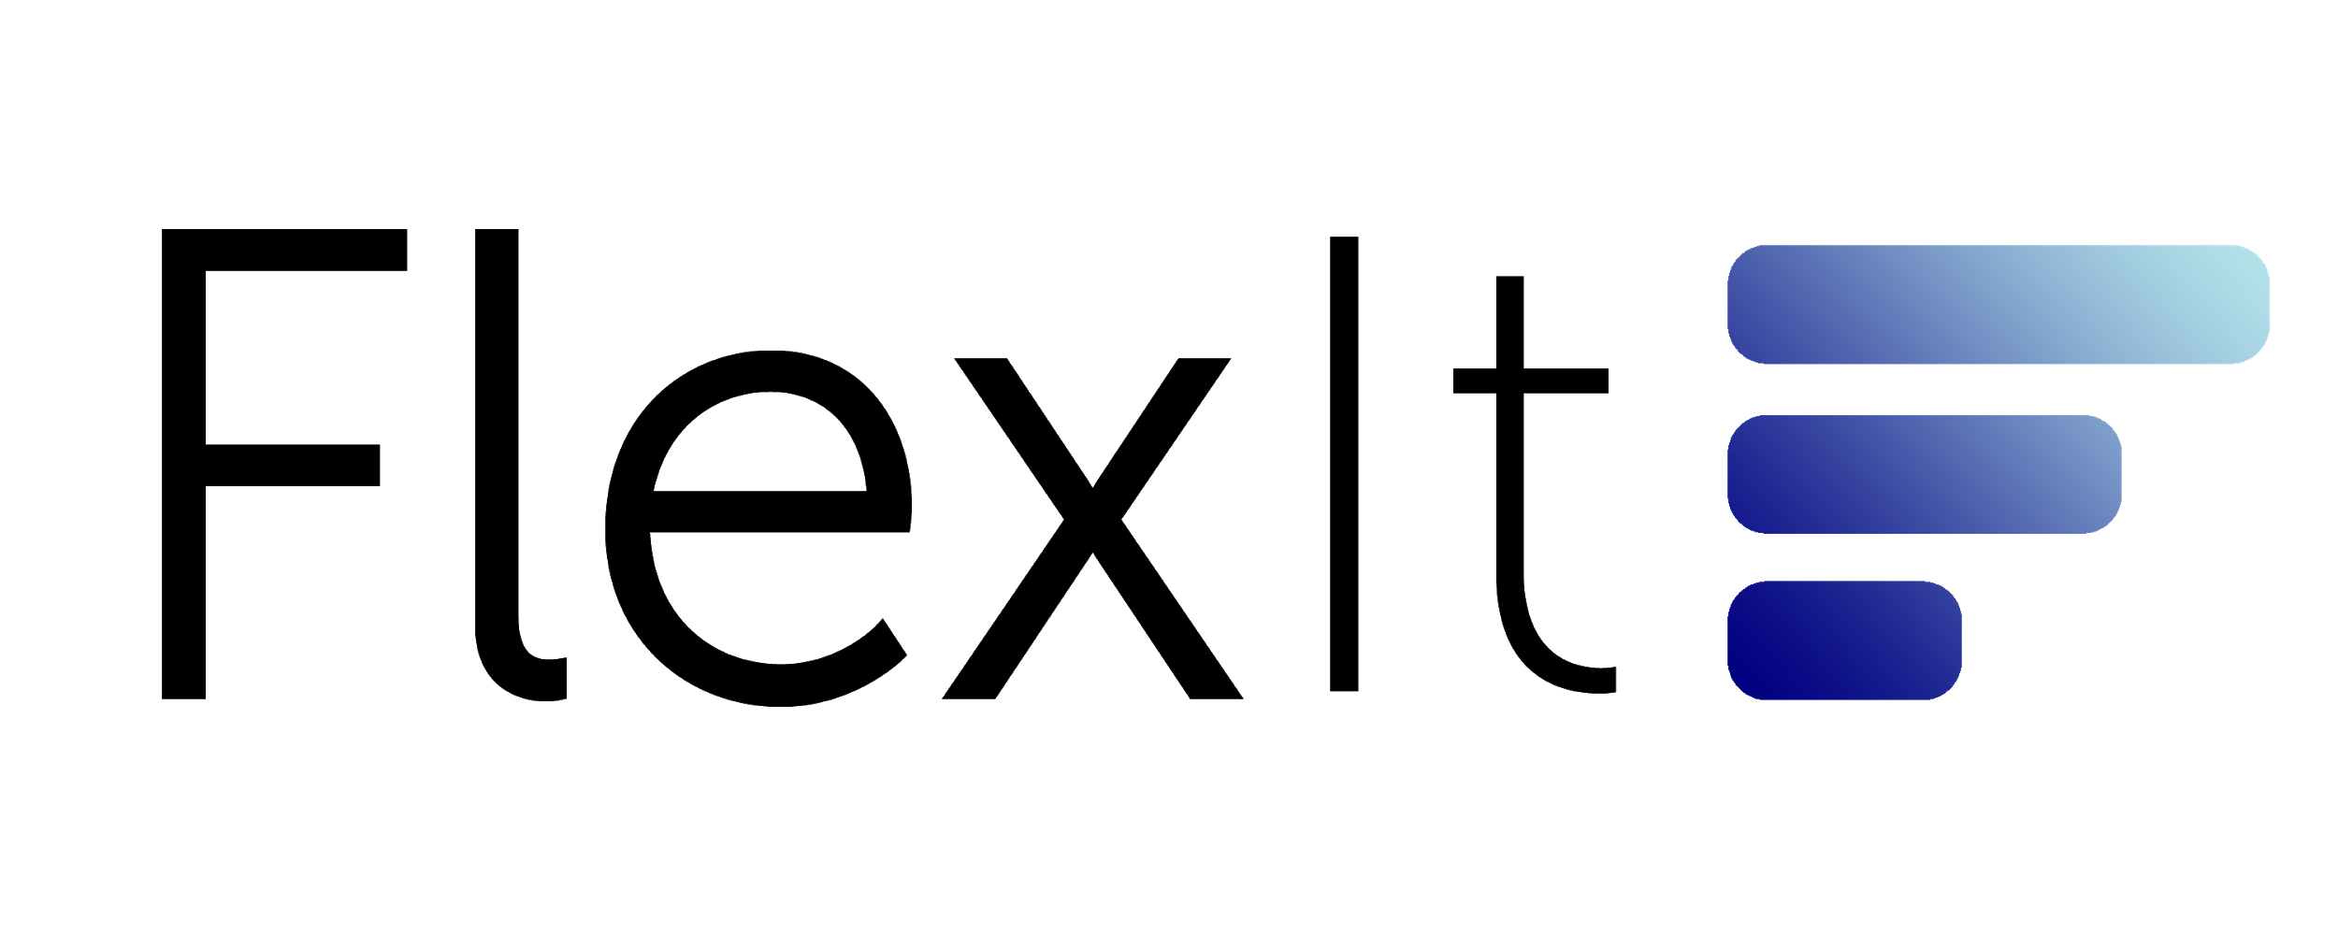
The FlexIt Customer Solution
An a-la-carte, non-membership solution to access health & fitness clubs wherever, whenever
Discover
Check-in
gyms and classes in your community
with a quick and easy scan
Review
FlexIt!
your activity and progress
using the mobile app
Notes:
Not actual screens, just visual representations.

Slide 18
FlexIt has a sustainable approach to acquiring customers
Social Media
Influencer
Partnerships
Cost: $$
Effectiveness: High
Cost: $$
Effectiveness: High
Cost: $$
Effectiveness: High
PR
Digital
Offline
Cost: $$
Effectiveness: High
Cost: $$
Effectiveness: High
Email
Cost: $$
Effectiveness: High
Cost: $$
Effectiveness: High
Notes:
Let’s clean slides 13-15 up once the model is done
Based on experience

Slide 19
FlexIt has a sustainable approach to acquiring customers
Digital
Cost: $$
Effectiveness: High
Digital
Cost: $$
Effectiveness: High
Digital
Digital
Digital
Cost: $$
Effectiveness: High
Cost: $$
Effectiveness: High
Cost: $$
Effectiveness: High
Digital
Digital
Cost: $$
Effectiveness: High
Cost: $$
Effectiveness: High
Notes:
Let’s clean slides 13-15 up once the model is done
Based on experience

Slide 20
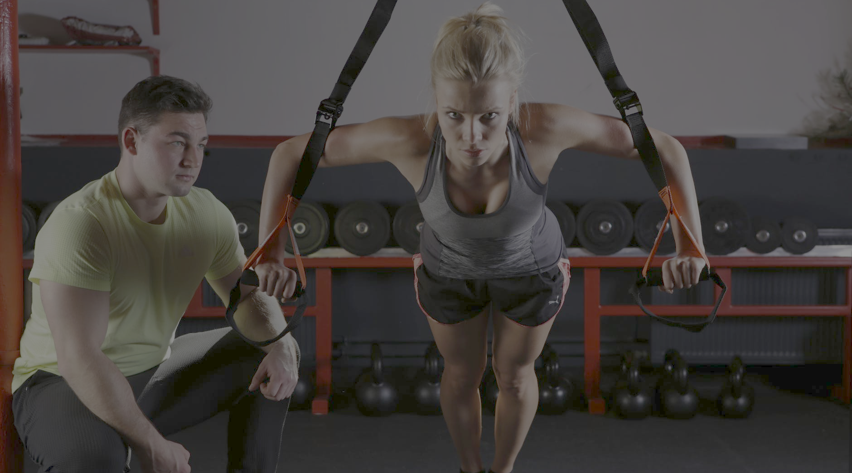
FlexIt provides on-demand access to gyms so that users can enjoy the privileges of membership without the hassle
Just choose a club, check-in, pay for the time you use, and check-out
Full control, maximum flexibility and convenience and access to all facility amenities
Benefits to Gym-Goers
Rates are by-the-minute and are more competitive and affordable than any other option in the market
Just choose a club, check-in, pay for the time you use, and check-out
Enjoy the privileges of membership without guilt or commitment
Full control, maximum flexibility and convenience and access to all facility amenities
Flexible
Rates are by-the-minute and are more competitive and affordable than any other option in the market
Convenient
Experiential
Affordable
Notes:
Not actual screens, just visual representations.

